Slide 1

Spring/Java Cloud-Native Bootcamp
Notes:
Learn more

Slide 2
Goal of this boot camp.
Introduce you to practices, platforms and tools for building modern Java applications.

Slide 3

Hi there.
Who are we?
Notes:
speaker intros

Slide 4
9-9:15AM | Introduction
9:15-9:30AM | Getting good at software
9:30-10AM | All about microservices
10-10:15AM | What’s cloud-native all about?
10:15-10:45AM | Introducing Cloud Foundry
10:45-11AM | BREAK TIME
11-12:30PM | Cloud-native Java technologies and patterns
12:30-1PM | LUNCH
1-4PM | Hands on exercises
4-4:30PM | Wrap up
Notes:
agenda

Slide 5
Why do you need to be good at software?
Meet demand to operate at scale.
Gives you more business options.
Your competitors are doing it.
It makes everyone happier.
Customers expect it.
Notes:
the need to be good at software
customer UX matters
operate at scale
new business opportunities
improve EVERYONE’S satisfaction

Slide 6
Improved speed. Faster cycle time, more frequently deployments.
Improved scale. More requests per second to apps and services.
Improved stability. Greater uptime of customer-facing service.
Improved security. Achieving 100% patch coverage.
Improved simplicity. Reduce complexity of processes and tools.
Ok, but how do I know that I’m doing well at software?
Notes:
Measuring ROI

Slide 7
What are microservices?
It refers to an architectural style that supports constant change in your environment. This is accomplished by creating applications out of independent, loosely-coupled, domain-oriented services.
Notes:
Defining microservices

Slide 8
Microservices architecture | Monolithic architecture
Single focused services. | Software solves many challenges in one software package.
Loosely coupled. | Tightly coupled.
Delivered continuously. | Delivered all together, on a schedule.
Scale independently. | Scale everything together.
Independent teams own service lifecycle. | Many teams own pieces of the service lifecycle.
Emphasis on distributed systems patterns. | Emphasis on delivery and organizational processes.
Diverse technologies managed through automation. | Single, long-lived technology stacks.
Short onboarding period for new developers. | Larger codebase requires significant time to ramp up new team members.
Notes:
Monoliths aren’t BAD
Challenges when it comes to scaling, making and shipping changes, onboarding new people, coordinating parallel dev efforts, long term commitment to a given tech stack

Slide 9
Do you have a pressing reason to do it?
Can you rearrange your teams?
Are you ready to decompose your monoliths?
How will you decompose?
Are you currently doing CI / CD?
Is your production environment automated?
How will you discover services at runtime?
What can you do to prevent cascading failures?
Are you ready to evolve your data platforms?
Do you need to modernize your messaging and event stream processing toolchain?
Are you ready for modern logging, monitoring?
Moving to microservices? Here’s what to consider.
Notes:
New challenges
Where to store shared info, how to track everyone,

Slide 10
What is “cloud-native” all about?
This is an approach to building and operating software that takes advantage of the cloud-computing model. Often seen as a combination of microservices, continuous delivery, containers, and DevOps.
It’s all about software that’s built for scale, built for continuous change, built to tolerate failure, built for manageability.
Notes:
Defining “cloud native”
Not about where, but HOW you build and run your app.

Slide 11
Most cloud-native applications comply with the 12 factor criteria.
One codebase tracked in version control
Explicitly declared dependencies
Configurations stored in the environment
Backing services treated as attached resources
Separate build, release, and run stages
Apps executed as stateless processes
Services exported via port binding
Scaled out via more processes
Fast startup and graceful shutdown
Parity among dev, staging, and production environments
Logs treated as event streams
Admin tasks run as one-off processes
Notes:
12 factor apps
https://12factor.net/

Slide 12
Cloud Native
Microservice architecture
API-first design
There’s a maturity model on your way to cloud native.
Designed for failure
Apps unaffected by dependencies
Proactive failure testing
Metrics and monitoring baked in
Cloud agnostic runtime
Cloud Resilient
Twelve factor app
Horizontal scalable
Leverage platform for HA
Cloud Friendly
No file system dependency
Self contained application
Platform managed ports/address
Consume off-platform services
Cloud Ready
Notes:
Maturity model.
Typically infrastructure independent, automated scaling, loosely coupled, in DevOps orgs, modern security approach

Slide 13
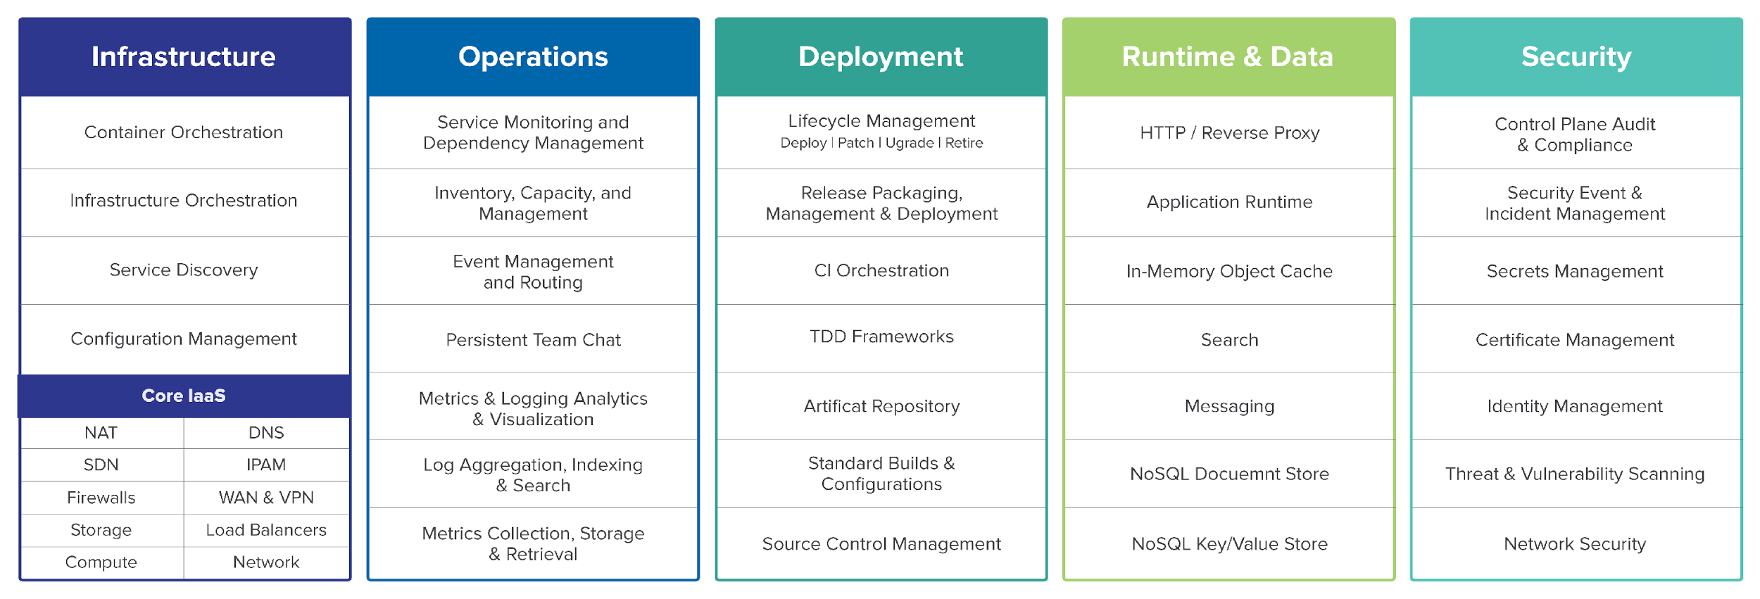
So, what actually makes up a cloud-native platform?
Notes:
What makes up a platform? What exactly is Cloud Foundry?

Slide 14


Pivotal Cloud Foundry Architecture
DYNAMIC ROUTE SERVICES / API MANAGEMENT
YOUR APPLICATIONS
PIVOTAL
APPLICATION
SERVICE
APP MICROSERVICES TECHNOLOGY
DATA MICROSERVICES TECHNOLOGY
Spring Boot
Steeltoe
Spring Cloud Services
Spring Cloud Data Flow
Cloud Cache
RabbitMQ
MySQL
MODERN
CLOUD NATIVE
PLATFORM
PLATFORM
Orgs, Spaces, Roles and Permissions
SERVICE
BROKER API
Elastic Runtime
Concourse
App
Autoscaler
PCF Metrics
CredHub
PIVOTAL
CLOUD FOUNDRY
BOSH
EMBEDDED OS
CONTAINER ORCHESTRATION
Windows
Linux
CLOUD ORCHESTRATION
MULTI CLOUD
Amazon
Web Services
Microsoft
Azure
Google
Cloud
Platform
Open Stack
VMWare

Slide 15

WE build the container
YOU build the container
Continuous
delivery
Application Code & Frameworks
Buildpacks | Spring Boot | Spring Cloud | Steeltoe
Github
Public Cloud Services
Pivotal Network
Open Service Broker API
Pivotal Application Service (PAS)
Pivotal Container Service (PKS)
Pivotal Services Marketplace
Customer Managed Services
Concourse
>cf push
>kubectl run
Pivotal and
Partner Products
v1
CVEs
Product Updates
Java | .NET | NodeJS
Elastic | Packaged Software | Spark
v2
“3Rs”
v3
...
Embedded OS
(Windows & Linux)
NSX-T
Repair
— CVEs
Repave
Rotate
— Credhub
Concourse
CPI (15 methods)
vSphere
Openstack
AWS
Google Cloud
Azure & Azure Stack
Notes:
Pivotal Cloud Foundry is Infrastructure agnostic multi-cloud platform. PCF can run on public cloud, whether its GCP, AWS or Azure. It can run on Openstack as well as on Prem on VMware. So the platform experience for the Operators is same across the cloud providers.
This is made possible by BOSH. It acts as a glue between Infrastructure and the Platform. BOSH interacts with Infrastructure using CPI (which is Cloud Provider Interface) thus provides abstraction from different cloud provider specific APIs.
BOSH is an open source tool for release engineering, deployment and lifecycle management of large scale distributed services.
From security point of view, BOSH enables to continuously update platforms to limit impact of threats. We apply the 3Rs of security. Repair CVEs, Repave bad nodes with last good state quickly, and constantly rotate credentials hence reducing the shelf life. You can use concourse pipelines to pull CVEs and Product Patches from Pivotal Network and Apply on the platform, without any down time. It has embedded OS for both Windows and Linux. It also integrates with NSX-T, to provide Software Defined Networking
On top of BOSH sits these 3 Platform Offerings and a 4th one on it’s way (I’ll touch on 4th one in a little bit).
First is PAS, which is PaaS offering. It is for running modern cloud native applications. Next is PKS which is CaaS offering, This is GKE compatible Kubernetes. We recommend to use PKS for running packaged software (like ES or Spark) or legacy apps which does not justify investment of modernization but you still would like to leverage the infrastructure elastic capabilities. And then we have Marketplace where we offer curated services which can be made available to your apps very easily - Database as a Service (like mysql), Data grip as a service (like Redis), Messaging as a Service (like Rabbit) as well as several partner services. This is achieved using Open Service Broker API and also enables platform to integrate seamlessly with Public Cloud or your custom managed services. You will see later in demo and workshop when we use Azure services on PCF.

Slide 16








Platform Runtime - PAS
Services
HA Proxy LB
Service Broker
Dynamic Router
Service Nodes
App Manager UI
Cloud Controller
CC-Bridge
Service
Application Manager
UAA
Login Server
Diego
Service Broker
Auctioneer
BBS
Service Nodes
Windows
Cell
Rep
Linux
Cell
Rep
Service
CLI – Cmd Line
Executor
Executor
Terminal Window
+
=
Service Broker
Service Nodes
Messaging (NATS)
Service
Metrics Collection
App Log Aggregator
Notes:
The router routes incoming traffic to the appropriate component. It interrogates BBS (Bulletin Board System) to keep it’s routing table updated about where an app is running.
The UAA(User Account & Auth) and Login Server work together to provide identity management - static login, SSO, SAML, AD
The Cloud Controller (CC) directs the deployment of applications. To push an app to Cloud Foundry, you target the Cloud Controller
CC Bridge is the integrator between Diego and CC. It has components which helps stage an app deployment, monitors actual and desired no of instances, provides info about the app back to CC.
Diego is the Brain - the container management system.
When you push an app to Cloud Foundry
The Cloud Controller sends a request to the BBS API.
The BBS contacts the Auctioneer to create an Auction based on the desired resources for that App. The Rep accepts the Auction request.
The Rep creates a Garden container and executor executes the work encoded for the App. This work is encoded as a generic, platform-independent recipe of composable actions.
Diego sends real-time streaming logs to the Loggregator system and metrics to metrics system. This is hooked to PCF Metrics dashboard and can also be hooked to external aggregators like spunk via Firehose (which is a web socket endpoint). Diego also registers its running instances with the Gorouter (dynamic router) to route external web traffic to them.
Diego interacts using an open source messaging system called as NATS which is written in GO.

Slide 17
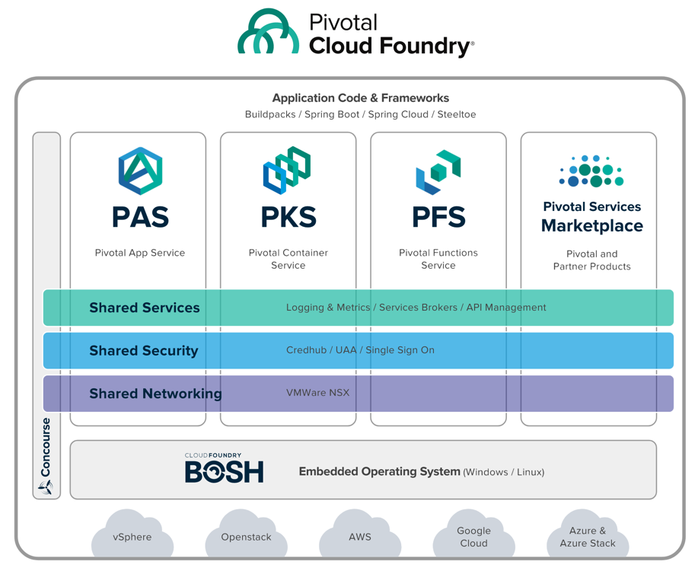
PCF 2.0
Any App
Every Cloud
One Platform
Notes:
As I was saying earlier, later this year we will be launching Pivotal Function Service is FaaS offering. It is based on an Open source project RIFF. RIFF IS FOR FUNCTIONS. It’s a polygon FaaS project. You can use Java, .Net, Pythin, Ruby etc

Slide 18
Deploying .NET applications? It doesn’t have to be terrible.
Traditional .NET deployment on VMs | Pivotal Cloud Foundry
Provision a VM Configure IP, DNS Configure firewall Windows updates, reboot… Install IIS Deploy application Configure app pool Configure SSL Configure load balancer | ~$ cf push
Notes:
Now scale your app. I’ll wait.
Go get another VM, figure out if it has what you need, duplicate your web server configs, update the LB, open up firewalls. Will you EVER scale down?
Still have to go package your code into an MSI, performing rolling upgrades, get code onto machines, run scripts, etc.

Slide 19

Code Complete & Tested
Find available hosts
Install & configure runtime
Install & configure middleware
Pull application source code
Retrieve dependent libraries
Create application package
Install, configure dependent service(s)
Deploy container to host(s)
Load environment variables
Configure load balancer
Configure firewalls
Update service monitoring tools
Configure log collector
45
seconds
later
~$ cf push
Application in Production

Slide 20
$ cf push my-app -p target/myapp.jar
or
$ cf push my-app --docker-image pivotal/my-image
Notes:
Cf push

Slide 21
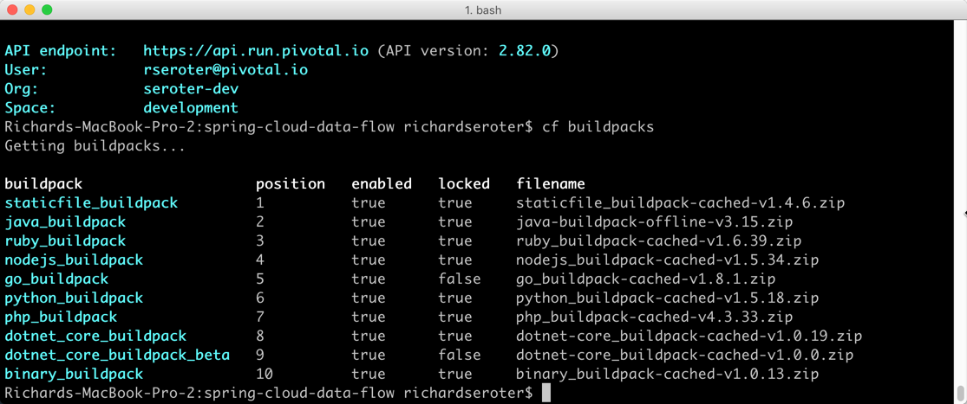
Buildpacks are language-aware
Notes:
Buildpacks provide framework and runtime support for apps. Buildpacks are language aware and typically examine your apps to determine what dependencies to download and how to configure the apps to communicate with bound services. When you push an app, Cloud Foundry automatically detects an appropriate buildpack for it. This buildpack is used to compile or prepare your app for launch.

Slide 22
Deploy source code that the platform containerizes for you
or
Deploy container images that you build yourself
Notes:
Here’s the difference between experience of Deploying code to PAS in comparison to deploying containers

Slide 23
Cloud Foundry
Deploy source code that the platform containerizes for you
or
Deploy container images that you build yourself
Developer
Cloud Controller triggers staging
Diego creates container
push source code
Diego lays down buildpack, source code
Diego mounts root file system
Diego builds and uploads droplet
Diego schedules containers onto Cells
Running app!
Notes:
How Cloud Foundry supports containers as a deployment unit (vs buildpacks)
When staging complete the output consists of metadata from the buildpack and a droplet, which is an archive of files that should be layered on top of the Root Filesystem. Cloud Controller asks Diego to launch instances of the application. Diego does this by scheduling containers on the Cells.
File System: The running application container contains the Root Filesystem and a copy of the application droplet.
Metadata: Cloud Controller provides Diego with metadata to launch the correct process within the Cloud Foundry Container Environment and to monitor the process’ health.

Slide 24
Cloud Foundry
Deploy source code that the platform containerizes for you
or
Deploy container images that you build yourself
Developer
Cloud Controller triggers staging
Diego spins up container to get metadata
Push Docker image
Developer
Generate and upload image
Diego schedules container onto Cells
Cloud Controller stores metadata
Developer
Create Dockerfile
Running app!
Developer
Identify base Docker image
Developer
Package source code
Notes:
How Cloud Foundry supports containers as a deployment unit (vs buildpacks)
After the metadata arrives, Cloud Controller asks Diego to launch instances of the application. Diego does this by scheduling containers on the Cells.
File System: Garden will download and cache the Docker image layers. It will then mount these layers into the Container file system. Some of the code that Garden uses for this process is shared code that is also used with Docker/OpenShift. Note that Garden will only download layers that have not been cached.
Metadata: Cloud Controller provides Diego with metadata to launch the correct process within the Cloud Foundry Container Environment and to monitor the process’ health.

Slide 25
Builds OCI-compatible containers
Generates both Linux and Windows containers
Option to SSH into running containers
Can rebuild containers to patch root file system
Performs log aggregation and correlation
Offers monitoring and auto scaling of containers
Introduces policy-driven container networking
Can attach persistent storage volumes
Intercept traffic via Route Services
Securely connect to outside services via Broker
Secure-by-default approach to containers
Cloud Foundry offers exceptional support for containers at runtime.
Notes:
How Cloud Foundry supports containers

Slide 26
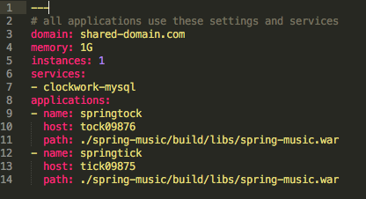
Define application metadata in a manifest file.
Application manifests tells cf push what to do with applications
What OS stack to run on: Windows or Linux
How many instances to create and how much memory to use.
Helps automate deployment, specially of multiple apps at once
Can list services to be bound to the application
YAML format – http://yaml.org
Notes:
As we talked that you can cf push your app and run and let PCF detect the app and run it with appropriate build pack and config. You can also provide a manifest file where you can instruct PCF to deploy the app as per your requirements.

Slide 27
Built for multi-tenancy
Push code or containers
Application manifests written in YAML
Injects environment variables
Aggregates app logs, correlates with metrics
Monitors app health, reacts
Scale manually or automatically
Built in data services, marketplace
Manages apps and underlying VMs
Natively runs on multiple IaaS platforms
Four layers of high availability built in
Access via GUI, REST API, CLI
Dev GUI = Applications Manager
Ops GUI = Operations Manager
Things about Pivotal Cloud Foundry you should know.
Notes:
Before we get into demo, here is the recap about PCF.
4 layers – app (container), process, VM, rack or data center

Slide 28
demo

Slide 29
break time

Slide 30
Service Brokers
SESSION FIVE
Notes:
Agenda:
Monolith
Domain Driven Design
Cloud Native

Slide 31
Pivotal Cloud Foundry Service Designs
Principles
Store Configs in the Environment
Backing Services are Attached Resources
User-Provided Services
App2App Binding
Developer Enablement
Marketplace
Managed
Service Instance Lifecycle
Service Catalogue
Instancing
Reserved
Shared

Slide 32
Open Service Broker API
The Open Service Broker API project allows for a single, simple, and elegant way to deliver services to applications.
Define and evolve the Open Service Broker API as a specification
Conformance test suite to verify both consumer and producer behaviors
Broad industry adoption in support of the end user community
Fujitsu, Google, IBM, Pivotal, RedHat and SAP

Slide 33
Azure Service Broker
Meta Service Broker
Node.JS
Deployable to Cloud Foundry
Production Ready
First Party
Azure MySQL
Azure CosmosDB
Azure Redis Cache
Et al
Open Service Broker
Golang
Targets
Pivotal Cloud Foundry
Kubernetes (PKS)
Active Alpha Development
First Party
Azure CosmosDB
Et al

Slide 34
VCAP_SERVICES
{
"VCAP_APPLICATION": {
"application_id": "c1aea30c-f64e-4254-9549-844fae002b7f",
"application_name": "app-usage-server",
"application_uris": [
"app-usage.sys.emea.reboot3times.org"
],
"application_version": "8130de90-e9da-4120-bc4c-88d711b07567",
"cf_api": "https://api.sys.emea.reboot3times.org",
"limits": {
"disk": 1024,
"fds": 16384,
"mem": 1024
},
"name": "app-usage-server",
"space_id": "7715cadf-b9db-409d-a0b7-b3b9af2d6309",
"space_name": "system",
"uris": [
"app-usage.sys.emea.reboot3times.org"
],
"users": null,
"version": "8130de90-e9da-4120-bc4c-88d711b07567"
}
}
Notes:
The server is easily embeddable in a Spring Boot application using the @EnableConfigServer annotation.
Application configuration data is stored in a backend
Git, Subversion and File System backends are supported
Git is the default backend. It's great for auditing changes and managing upgrades
Setting the git backend is done via the spring.cloud.config.server.git.uriconfiguration property

Slide 35
Introducing Spring Boot
SESSION TWO

Slide 36

What’s Spring Been Up To?

Slide 37
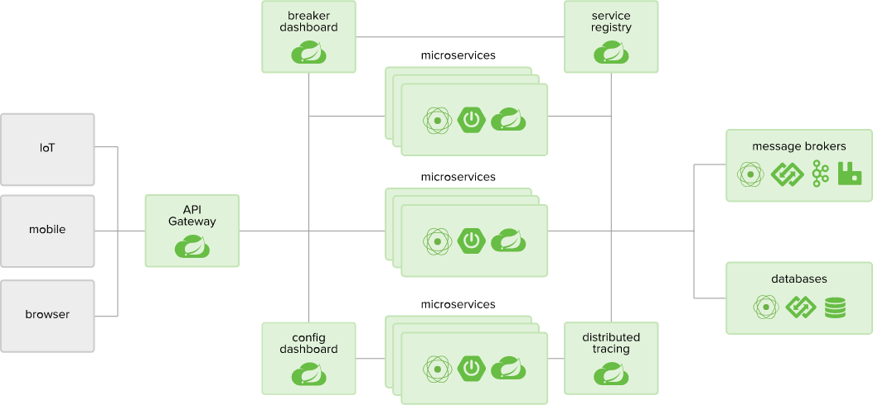
Spring Opportunities
Notes:
History of Spring. Replaces Java EE as a the “standard” Java Framework. Cover some high-level values of Spring.

Slide 38
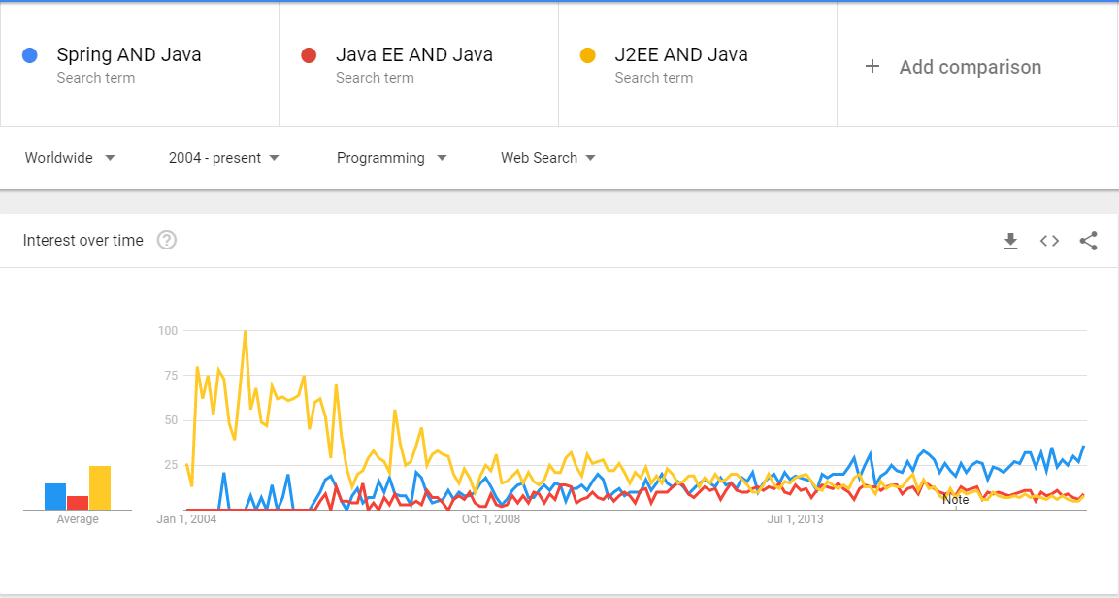
Spring vs Java EE
Notes:
History of Spring. Replaces Java EE as a the “standard” Java Framework. Cover some high-level values of Spring.

Slide 39
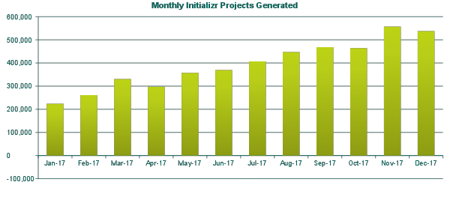
Spring Boot Popularity
Notes:
History of Spring. Replaces Java EE as a the “standard” Java Framework. Cover some high-level values of Spring.

Slide 40
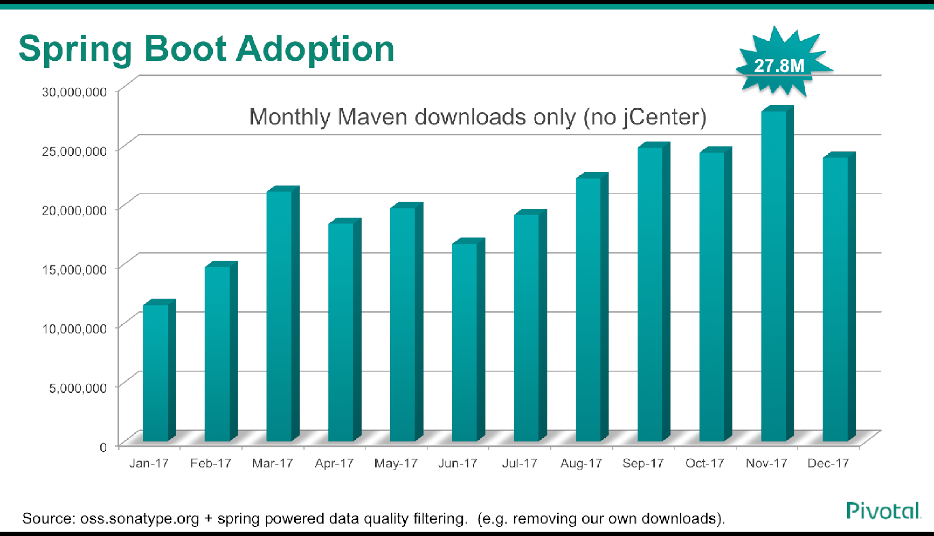

Slide 41
Aspect-Oriented Programming
Separation of Concerns through Modularity.
Annotations
Dependency Injection
Abstract Implementation
Encapsulation
Enables cross-cutting functionality

Slide 42
What is Spring Boot?

Slide 43
Spring Boot
package hello;
import org.springframework.boot.*;
import org.springframework.boot.autoconfigure.*;
import org.springframework.stereotype.*;
import org.springframework.web.bind.annotation.*;
@Controller
@EnableAutoConfiguration
public class SampleController {
@RequestMapping("/")
@ResponseBody
String home() {
return "Hello World!";
}
public static void main(String[] args) throws Exception {
SpringApplication.run(SampleController.class, args);
}
}
An opinionated view of building production-ready Spring applications. Spring Boot favors convention over configuration and is designed to get you up and running as quickly as possible.

Slide 44
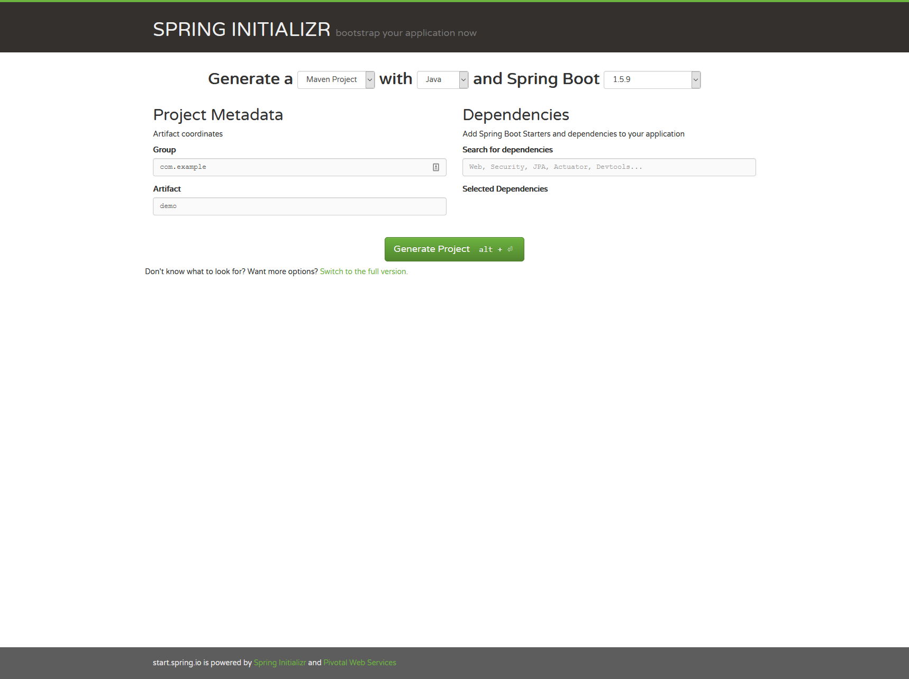
Spring Initializr
Spring Initializr provides an extensible API to generate quickstart projects. It provides a simple web UI to configure the project to generate and endpoints that you can use via plain HTTP.

Slide 45
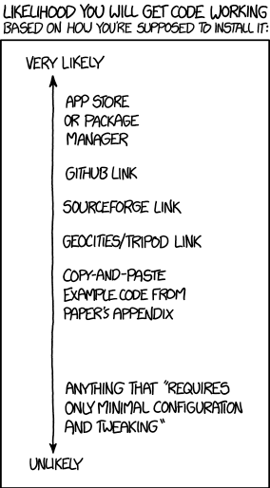
Application Packaging
Find
Download
Compile
Pray
Image Source: https://xkcd.com/1742/

Slide 46

Spring Packaging

Slide 47
Primary Execution
package hello;
import java.util.Arrays;
import org.springframework.boot.SpringApplication;
@SpringBootApplication
public class Application {
public static void main(String[] args) {
SpringApplication.run(Application.class, args);
}
}
Notes:
@SpringBootApplication is a convenience annotation that adds all of the following:
@Configuration tags the class as a source of bean definitions for the application context.
@EnableAutoConfiguration tells Spring Boot to start adding beans based on classpath settings, other beans, and various property settings.
Normally you would add @EnableWebMvc for a Spring MVC app, but Spring Boot adds it automatically when it sees spring-webmvc on the classpath. This flags the application as a web application and activates key behaviors such as setting up a DispatcherServlet.
@ComponentScan tells Spring to look for other components, configurations, and services in the hello package, allowing it to find the controllers.

Slide 48
REST Controller
package hello;
import org.springframework.web.bind.annotation.RestController;
import org.springframework.web.bind.annotation.RequestMapping;
@RestController
public class HelloController {
@RequestMapping("/")
public String index() {
return "Greetings from Spring Boot!";
}
}
Notes:
The class is flagged as a @RestController, meaning it’s ready for use by Spring MVC to handle web requests. @RequestMapping maps / to the index() method. When invoked from a browser or using curl on the command line, the method returns pure text. That’s because @RestController combines @Controller and @ResponseBody, two annotations that results in web requests returning data rather than a view.

Slide 49
Unit Testing Controllers
@RunWith(SpringRunner.class)
@SpringBootTest
@AutoConfigureMockMvc
public class HelloControllerTest {
@Autowired
private MockMvc mvc;
@Test
public void getHello() throws Exception {
mvc.perform(MockMvcRequestBuilders.get("/")
.accept(MediaType.APPLICATION_JSON))
.andExpect(status().isOk())
.andExpect(content().string(equalTo("Greetings from Spring Boot!")));
}
}
Notes:
The class is flagged as a @RestController, meaning it’s ready for use by Spring MVC to handle web requests. @RequestMapping maps / to the index() method. When invoked from a browser or using curl on the command line, the method returns pure text. That’s because @RestController combines @Controller and @ResponseBody, two annotations that results in web requests returning data rather than a view.

Slide 50
Questions?
SESSION TWO
Notes:
Agenda:
Monolith
Domain Driven Design
Cloud Native

Slide 51
Advanced Spring Boot
SESSION FOUR

Slide 52
Common Challenges
“I have no idea what is going on. It’s responding but I don’t know if it’s healthy as requests are taking too long.”
“Our service pool seems fine but we’re not sure if traffic is being balanced properly.”
“We deployed a new version, but the deployment broke. We’re not sure how many versions are deployed.”

Slide 53
Production-Ready Endpoints
Actuator | AuditEvents | AutoConfig | Beans
ConfigProps | Dump | Env | Flyway
Health | Info | Loggers | Liquibase
Metrics | Mappings | Shutdown | Trace
Docs | HeapDump | Jolokia | Logfile

Slide 54
Actuator
Metrics
Health
Data
Info
Record
Gauges
Counters
Compose
Disk Space
Data Source Connection
JMS
Rabbit
Redis
...
Liquibase
Flyway
Configuration
Build Info
Git Version
Build Date
Notes:
actuator
Provides a hypermedia-based “discovery page” for the other endpoints. Requires Spring HATEOAS to be on the classpath.
Secure
auditevents
Exposes audit events information for the current application.
Secure
autoconfig
Displays an auto-configuration report showing all auto-configuration candidates and the reason why they ‘were’ or ‘were not’ applied.
Secure
beans
Displays a complete list of all the Spring beans in your application.
Secure
configprops
Displays a collated list of all @ConfigurationProperties.
Secure
dump
Performs a thread dump.
Secure
env
Exposes properties from Spring’s ConfigurableEnvironment.
Secure
flyway
Shows any Flyway database migrations that have been applied.
Secure
health
Shows application health information (when the application is secure, a simple ‘status’ when accessed over an unauthenticated connection or full message details when authenticated).
Not Secure
info
Displays arbitrary application info.
Not Secure
loggers
Shows and modifies the configuration of loggers in the application.
Secure
liquibase
Shows any Liquibase database migrations that have been applied.
Secure
metrics
Shows ‘metrics’ information for the current application.
Secure
mappings
Displays a collated list of all @RequestMapping paths.
Secure
shutdown
Allows the application to be gracefully shutdown (not enabled by default).
Secure
trace
Displays trace information (by default the last 100 HTTP requests).
Secure

Slide 55
Auto-Configured Health Indicators
DiskSpaceHealthIndicator | Checks for low disk space
DataSourceHealthIndicator | Validates DataSource connection
ElasticsearchHealthIndicator | Checks if Elasticsearch is up
JmsHealthIndicator | Checks if a JMS broker is up
MailHealthIndicator | Checks if a mail server is up
MongoHealthIndicator | Checks if MongoDB is up
RabbitHealthIndicator | Checks if RabbitMQ server is up
RedisHealthIndicator | Checks if Redis server is up
SolrHealthIndicator | Checks if Solr server is up
CassandraHealthIndicator | Checks if Cassandra DB is up
Notes:
@SpringBootApplication is a convenience annotation that adds all of the following:
@Configuration tags the class as a source of bean definitions for the application context.
@EnableAutoConfiguration tells Spring Boot to start adding beans based on classpath settings, other beans, and various property settings.
Normally you would add @EnableWebMvc for a Spring MVC app, but Spring Boot adds it automatically when it sees spring-webmvc on the classpath. This flags the application as a web application and activates key behaviors such as setting up a DispatcherServlet.
@ComponentScan tells Spring to look for other components, configurations, and services in the hello package, allowing it to find the controllers.

Slide 56
Custom Health Indicator
import org.springframework.boot.actuate.health.Health;
import org.springframework.boot.actuate.health.HealthIndicator;
import org.springframework.stereotype.Component;
@Component
public class MyHealthIndicator implements HealthIndicator {
@Override
public Health health() {
int errorCode = check(); // perform some specific health check
if (errorCode != 0) {
return Health.down().withDetail("Error Code", errorCode).build();
}
return Health.up().build();
}
}
Notes:
To provide custom health information you can register Spring beans that implement the HealthIndicator interface. You need to provide an implementation of the health() method and return a Health response. The Health response should include a status and can optionally include additional details to be displayed.

Slide 57
Profiles
Why?
Flexibility
Runtime
Feature Control
server:
port: 9000
---
spring:
profiles: development
server:
port: 9001
---
spring:
profiles: production
server:
port: 0

Slide 58
Questions?
SESSION FOUR
Notes:
Agenda:
Monolith
Domain Driven Design
Cloud Native

Slide 59
Spring Starters for Azure
SESSION FIVE
Notes:
Agenda:
Monolith
Domain Driven Design
Cloud Native

Slide 60
What are Spring Boot Starters?
Spring Boot Starters are a set of convenient dependency descriptors that you can include in your application. You get a one-stop-shop for all the Spring and related technology that you need, without having to hunt through sample code and copy paste loads of dependency descriptors.
For example, if you want to get started using Spring and JPA for database access, just include the spring-boot-starter-data-jpa dependency in your project, and you are good to go.
https://docs.spring.io/spring-boot/docs/current/reference/htmlsingle/#using-boot-starter
Notes:
Explain what the Starters are

Slide 61
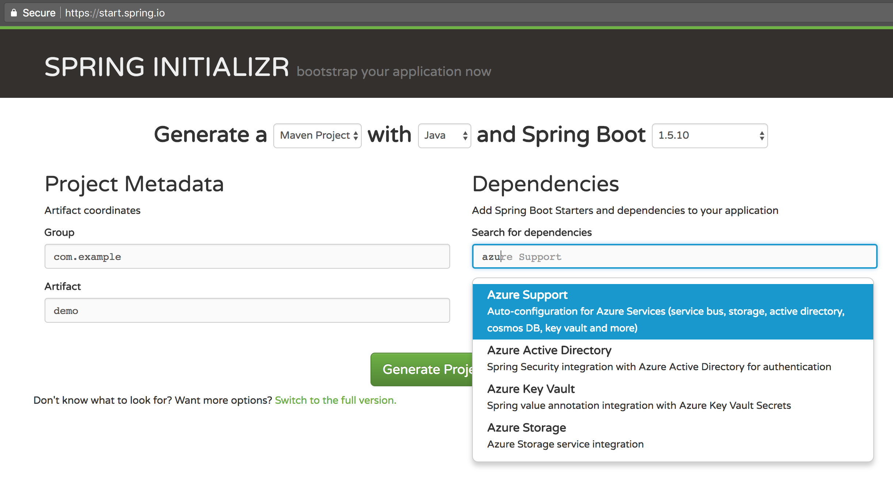
Spring Boot Starters for Azure
Notes:
Explain all the great work done by MSFT in collaboration with our Spring team to have their Starters published on start.spring.io Very importantly, explain here that these Starters will speed up how you build and deploy Spring apps to PCF. Mention that the next Lab will cover Azure Spring Boot Starters + Azure Service Broker

Slide 62
lunch time

Slide 63
Spring Cloud Services
SESSION FIVE

Slide 64
Cloud Native Architectures
Scalability
On-Demand Provisioning
Service Discovery
Routing
Load Balancing
Stream Manipulation
Resiliency
High Availability
Continuous Delivery
Chaos Testing
Routing
Circuit Breaking
Failure Resolution

Slide 65

Netflix Cloud
Driving Factors
Time to Delivery
Pioneering Architectures
Subset of the Whole
Notes:
Have to be able to scale in response to surges, add new features rapidly. Can’t go down for maintenance/upgrades.
NetFlix, an undisputed business & technology leader
34% of peak N. American internet traffic from 6-9pm
If speed was why they won, microservices was how
They pioneered / began to popularize micro service concept
All they had was Amazon EC2 back then
They had to invent a distributed platform, cloud native platform with PaaS – like features
They had to invent microservice infrastructure at the application level
All before writing one line of code that relates to the application you and I know as Netflix

Slide 66



Open Source Solutions
Notes:
Companies like Twitter, Facebook, and Hashicorp have open-sourced other cloud infrastructure libraries.
Complementary and competing solutions from top technology companies form a bazaar of ideas.

Slide 67

Spring Cloud Services
Aspect Oriented
Convention over Configuration
Cloud Connectors
Curated Libraries
Opinionation
Developer Simplicity

Slide 68



Spring Cloud Netflix
Client
Ribbon
Archaius
Hystrix
Feign
Zuul
Server
Eureka
Turbine
Notes:
Diving into Spring Cloud Netflix, for example, we see here some of the Netflix OSS projects for which Spring Cloud provides integrations.
Ribbon, the Netflix client-side load balancer, and Eureka, the Netflix discovery server, can be used together as we saw earlier where the client side load balancer loads routing information from the discovery server and applies its own load balancing rules.
Netflix Hystrix is an implementation of a circuit breaker. With Spring annotations, we can use AOP to add fallback commands to methods. We can also automatically report failures and metrics ass streams, in accordance with 12-factor app principles, and Netflix Turbine can collect these streams and provide an aggregated visualization into the state of all circuit breakers in the system.
------------------------------
Auxiliary notes:
Ribbon: A client load balancer. Ribbon loads routing info from Eureka. It has several implementations of load balancing rules. Ribbon is used internally by Feign
Feign: A declarative REST client. Allows annotation of interface to be mapped to endpoints. When combined with Ribbon it adds load balancing capabilities to the client interface
Hystrix: Circuit breaker pattern implementation. Via spring annotations add commands to methods using AOP. Protects clients from failures and reports metrics via a stream of HTTP events
Zuul: A set of HTTP filters do add routing, security. On spring it's used to create a CORS filter for UI apps to be able to access external services
Archaius: Dynamic configuration management. Used with Spring’s config server to allow dynamic properties loading
Eureka: Discovery server
Turbine: Event aggregation engine. It can combine several streams (hystrix) into one combined view, that can be view later on a dashboard

Slide 69











Spring Cloud Services, Connectors, Integrations
Circuit Breaker
Config Server
API Gateway
RabbitMQ
Service Registry
MySQL
Pivotal Cloud Cache
Pivotal GemFire
Pivotal Push Notifications
Redis
Riak
Session State Caching
Notes:
The talk track on this is not only about Spring Cloud integrations, but other integrations with Pivotal software, such as PCF, PCC, etc.

Slide 70

Spring Cloud
Notes:
How Spring builds on lower layers of open source to complete the whole Spring Framework.

Slide 71


Spring Cloud
Open Source
Modular
Cloud Ready
Agile

Slide 72
Questions?
SESSION FIVE
Notes:
Agenda:
Monolith
Domain Driven Design
Cloud Native

Slide 73
Spring Cloud Config
SESSION SIX

Slide 74
Spring Config Context
Configuration for Spring can generally be described as values which wire up Spring Beans
Externalizing Configurations
Command Line
Environment Variables
Spring Config Server
Challenges
Changes Require Restarts
No Auditing
HTTP-based API
Asymmetric & Symmetric Encryption Options
Spring Boot Embeddable

Slide 75
Configuration Workflow
Config Push
Git Server
Spring Cloud Config
Application Pool

Slide 76
Spring Config Server
application.yml
spring:
cloud:
config:
server:
git:
uri: <repo>
demo.yml
name: “mike”
@Configuration
@EnableAutoConfiguration
@RestController
public class Application {
@Value("${config.name}")
String name = "World";
@RequestMapping("/")
public String home() {
return "Hello " + name;
}
public static void main(String[] args) {
SpringApplication.run(Application.class, args);
}
}
Notes:
The transition from this slide to the next should be to talk about how this doesn’t scale very easily and you should use Cloud Bus.

Slide 77

Refreshing Context
Publisher -> Subscriber
Update all applications easily
Spring Cloud Bus
Easy as POST
One Command
Update Everywhere
Notes:
Requires the Cloud Bus AMQP dependency on the classpath (pom.xml).
<dependency>
<groupId>org.springframework.cloud</groupId>
<artifactId>spring-cloud-starter-bus-amqp</artifactId>
</dependency>

Slide 78
Spring Cloud Bus Workflow
1. Config Push
Application Pool
6. Receive Update
3. Spring Cloud Config
2. Git Server
4. POST /bus/refresh
5. Send Update
Notes:
Push the config.
Git updates.
Spring Config Server reads the new config.
Dev/Integration sends the POST to update the configs.
First application to receive the POST sends an update to Rabbit.
Rabbit publishes the change to the other applications subscribed.
Everyone is updated and happy.

Slide 79
Spring Cloud Services: Config Server
Cloud Foundry Marketplace
Automated Config Server Deployment
Specify Git URL
Bind onto Cloud Foundry App
Optionally bind in RabbitMQ for Cloud Bus
Notes:
Requires the Cloud Bus AMQP dependency on the classpath (pom.xml).
<dependency>
<groupId>org.springframework.cloud</groupId>
<artifactId>spring-cloud-starter-bus-amqp</artifactId>
</dependency>

Slide 80
Questions?
SESSION SIX
Notes:
Agenda:
Monolith
Domain Driven Design
Cloud Native

Slide 81
Spring Cloud Service Discovery
SESSION SEVEN

Slide 82
Distributed Service Challenges
Service Discovery
Dependencies are not Inter-Process Method Calls
Manual Configurations are difficult
Past Attempts
Service Locators
Dependency Injection
Service Registries

Slide 83
Service Discovery Pattern
1. Register
2. Discover
Consumer
3. Connect
Notes:
Push the config.
Git updates.
Spring Config Server reads the new config.
Dev/Integration sends the POST to update the configs.
First application to receive the POST sends an update to Rabbit.
Rabbit publishes the change to the other applications subscribed.
Everyone is updated and happy.

Slide 84
Spring Cloud Service Registry
Features
HTTP Interface
Client Libraries
Client Registry
Registry Server
Heartbeats
Service Catalogue
Exchange
Capabilities
Service Details
Name
Port
Health
URLs
Embeddable with Spring Boot
@EnableEurekaServer
@EnableDiscoveryClient

Slide 85
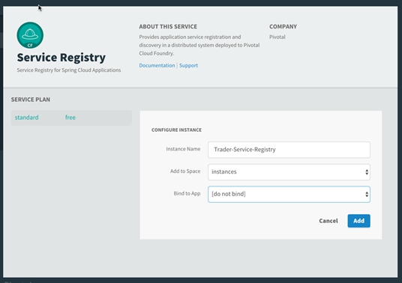
Spring Cloud Service Discovery for Pivotal Cloud Foundry
Better Together
Native Support for Automated Service Registry Server Deployment
Security-Optimized Eureka Service Instance with OAuth2
CF Service Binding Ready
Cloud Connectors for Automatic Reconfiguration

Slide 86
Spring Cloud Client-Side Features
Sidecar Designs
Run As Separate Process
Spring Cloud Ribbon
Client-Side Load Balancing HTTP Client
Multiple LB Algorithms for Consumption
Cloud-Aware with Support for Zones, Circuit Breakers
Spring Cloud Zuul
Reverse Proxy Support
API Gateway
Gateway Design
Authentication
Stress Testing
Canary Testing
Dynamic Client-Side Routing
Service Migration
Security
Active/Active Management

Slide 87
Client Services
@EnableDiscoveryClient
@EnableZuulProxy // <- for Zuul Reverse Proxy
@EnableConfigServer // <- for built-in Config Server
@SpringBootApplication
public class QuotesService {
public static void main(String[] args) {
SpringApplication.run(QuotesService.class, args);
}
}
Notes:
The server is easily embeddable in a Spring Boot application using the @EnableConfigServer annotation.
Application configuration data is stored in a backend
Git, Subversion and File System backends are supported
Git is the default backend. It's great for auditing changes and managing upgrades
Setting the git backend is done via the spring.cloud.config.server.git.uriconfiguration property

Slide 88
Questions?
SESSION SEVEN
Notes:
Agenda:
Monolith
Domain Driven Design
Cloud Native

Slide 89
Resiliency with Spring
Spring Cloud Circuit Breakers
SESSION EIGHT

Slide 90
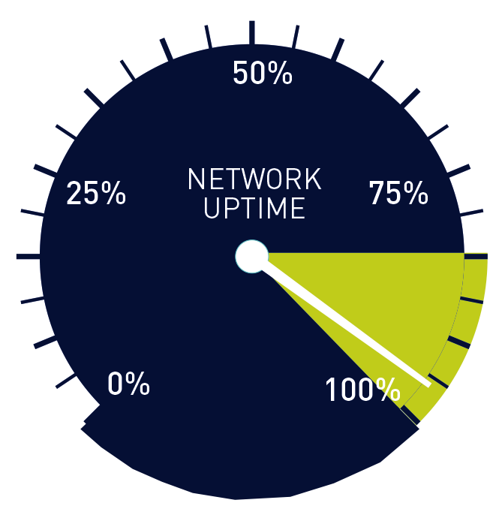
Fault Tolerance
Service Level Agreements
No Cascading Failures
99.9%
8h45m Yearly
99.99%
52m Yearly
Reality is Often Worse

Slide 91
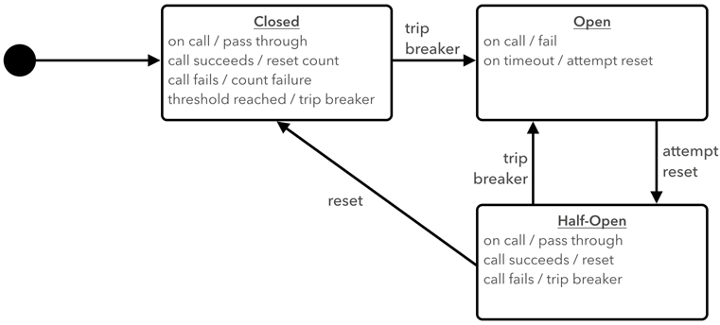
Circuit Breaker Pattern

Slide 92
Spring Cloud with Hystrix
Instrumentation through Dependency Injection
Hystrix Publishes Per-Implementation Metrics
Informational and Status
Gauges and Counters
Latency Percentiles
Latency Percentiles for End-To-End Execution
Property Values
Integration with Spring Actuators
Optional Publishing via Turbine and RabbitMQ

Slide 93
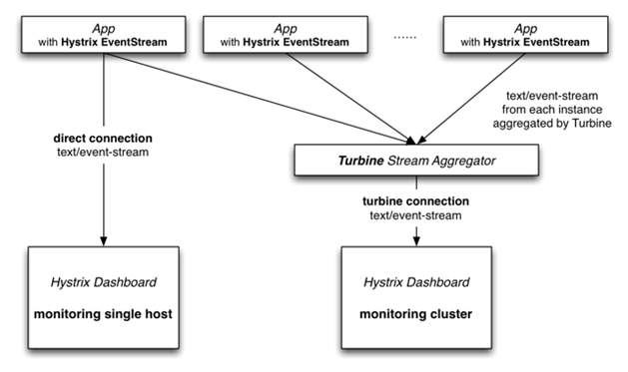
Hystrix with Turbine
Notes:
Show this video: https://www.youtube.com/watch?time_continue=1&v=zWM7oAbVL4g

Slide 94
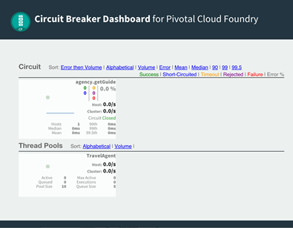
Spring Cloud Services for Pivotal Cloud Foundry
Better Together
Automated Deployment
Dashboard
Turbine
RabbitMQ
Service Bindings
Optional Spring Starter Dependency

Slide 95
Spring Cloud with Hystrix
@Service
public class BookService {
private final RestTemplate restTemplate;
public BookService(RestTemplate rest) {
this.restTemplate = rest;
}
@HystrixCommand(fallbackMethod = "reliable")
public String readingList() {
URI uri = URI.create("http://localhost:8090/recommended");
return this.restTemplate.getForObject(uri, String.class);
}
public String reliable() {
return "Cloud Native Java (O'Reilly)";
}
}
Notes:
The server is easily embeddable in a Spring Boot application using the @EnableConfigServer annotation.
Application configuration data is stored in a backend
Git, Subversion and File System backends are supported
Git is the default backend. It's great for auditing changes and managing upgrades
Setting the git backend is done via the spring.cloud.config.server.git.uriconfiguration property

Slide 96
Spring Cloud with Circuit Breaker
@EnableDiscoveryClient
@EnableCircuitBreaker // <- for Hystrix Integration
@SpringBootApplication
public class QuotesService {
public static void main(String[] args) {
SpringApplication.run(QuotesService.class, args);
}
}
Notes:
The server is easily embeddable in a Spring Boot application using the @EnableConfigServer annotation.
Application configuration data is stored in a backend
Git, Subversion and File System backends are supported
Git is the default backend. It's great for auditing changes and managing upgrades
Setting the git backend is done via the spring.cloud.config.server.git.uriconfiguration property

Slide 97
Questions?
SESSION EIGHT
Notes:
Agenda:
Monolith
Domain Driven Design
Cloud Native

Slide 98
Learn more!
http://pivotal.io/microservices
https://www.microsoft.com/net/learn/architecture
http://spring.io/
http://start.spring.io/
http://steeltoe.io
https://github.com/steeltoeoss
Notes:
resources

